Slide 1
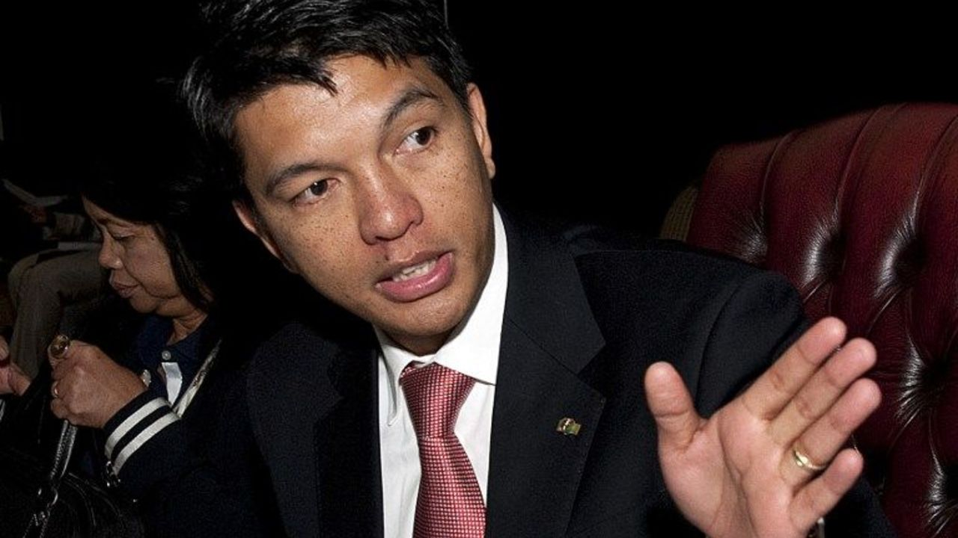
A FATHER
FOR THE LONELY
ADOLESCENT BOYS
IN MADAGASCAR
Mg.co.za
Notes:
Many Fathers are not available to care for the children because of many problems.
So contemporary families, counseling, youth ministry, try to support adolescents in their loneliness.
However there is a Call for a Father here because Malagasy people value nuclear family and fatherhood

Slide 2

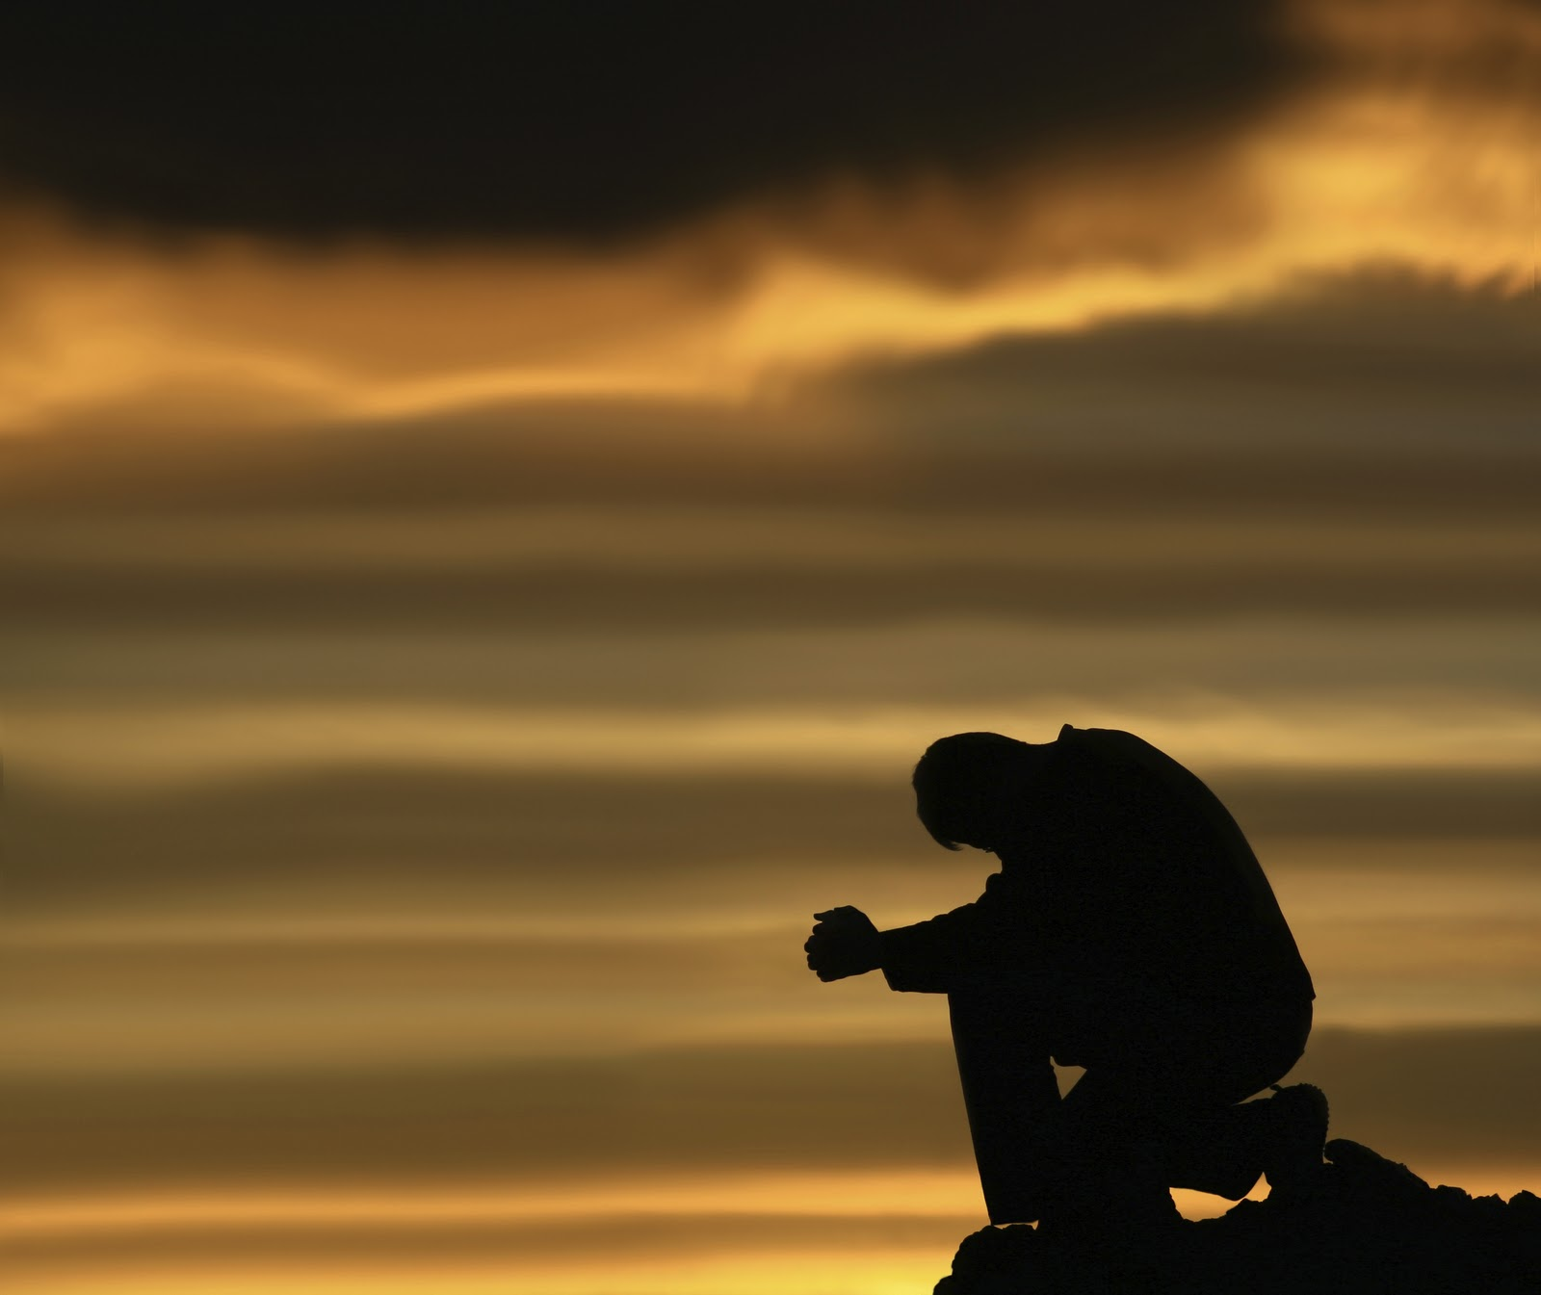
Loneliness
Solitude
Opportunity for fullness
Requires potential for fullness
Notes:
Loneliness is the emptiness in our hearts, the longing for connection and intimacy, a state of human being, not caused by sin, not good, not bad.
It tells us that to be a person, we must love and be loved.
The solitude in the loneliness is an opportunity for growth

Slide 3
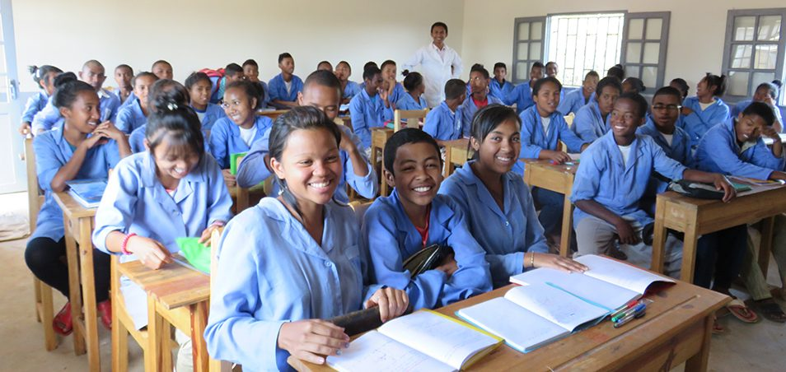
Notes:
Adolescence is the time between childhood and adulthood
There is a rapid change in the body and brain for the personal growth toward maturity.
The search for self-identity and maturity causes the crisis of loneliness in adolescents.

Slide 4
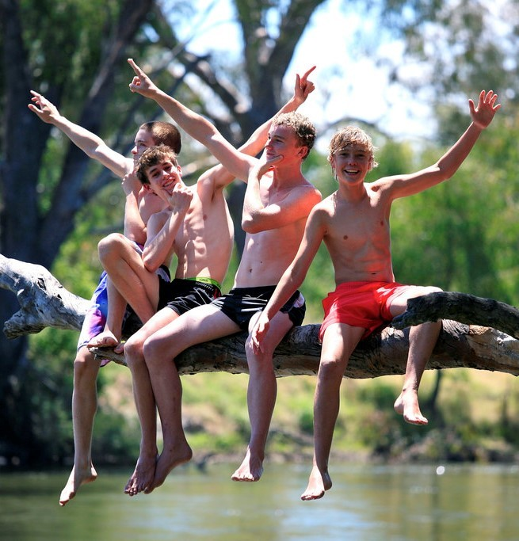
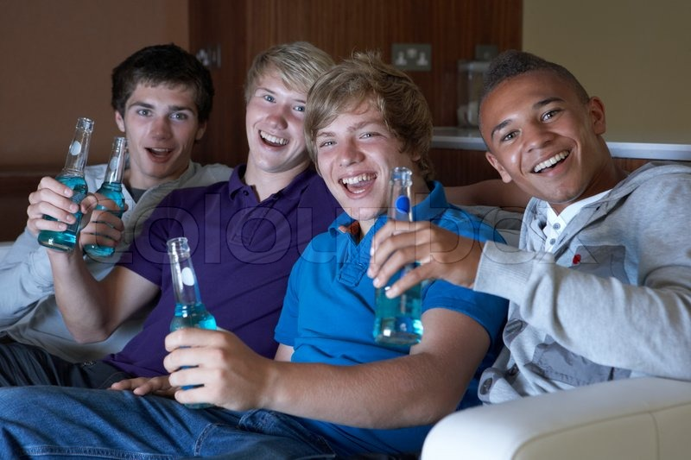

PEER GROUP NEW EXPERIENCES
This Photo by Unknown Author is licensed under CC BY-SA-NC
Notes:
They join a peer group of the same age, school, gender, with six or eight members because
in this group they find empathy and security to open up to new beliefs end values.
New experience train adolescents to be responsible adults

Slide 5

Notes:
The friendship and empowerment from the parents are important
in giving a freedom, teaching, training, setting rules, and supporting the adolescents.
The failure of the parents increases their loneliness and drives them to defective behaviors.

Slide 6
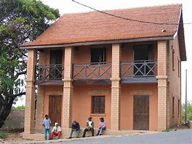
The Loneliness of Adolescent Boys in Madagascar
The Malagasy home
Notes:
A typical Malagasy family values nuclear family, Fathers are the head and breadwinner, and they hold the authority at home.
Children don’t leave the parents until they get married
They are supposed to be respectful

Slide 7
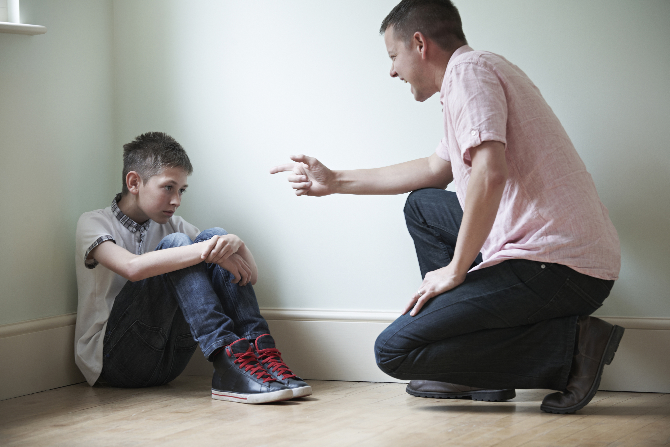
Domestic violence 70%
Notes:
Unfortunately, fathers are authoritative, possessive and violent toward the family which has impact to adolescents.
Divorce and poverty also make them feel hopeless,
and the inability to express who they are increases the loneliness as well.

Slide 8
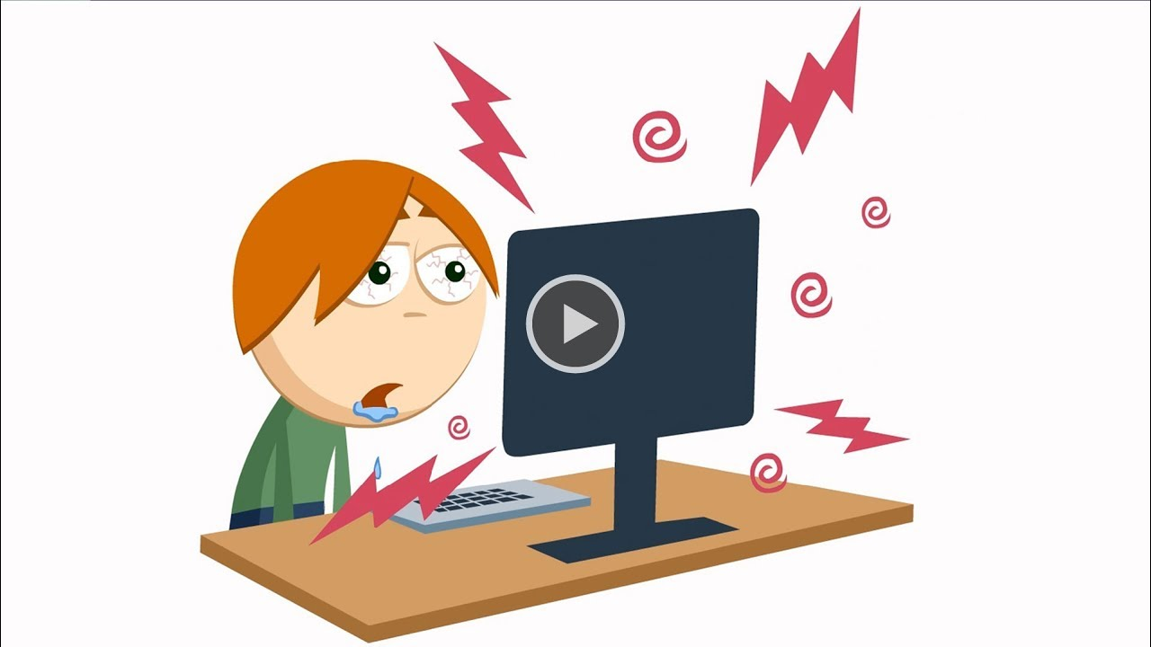
Youtube.com
Notes:
The development of science and technology creates
a frustration in their lives and confusion of their identity.
Also, the gap between parents and adolescents increases.

Slide 9
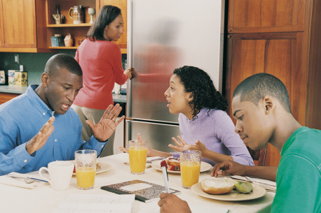
Notes:
Parents who are violent and severe in control don’t help the adolescents in the crisis.
They become lonelier in their frustration and anxiety that may cause temptation to addictions and defective behaviors

Slide 10
A father to break the cycle
Lonely fathers
Lonely boys
Notes:
If boys don’t have enough support in adolescence, they struggle to become adult,
They will be lonely fathers later and the cycle will continue to the next generation.
The call for a father is to be active in the parenting work to break this cycle of loneliness.

Slide 11
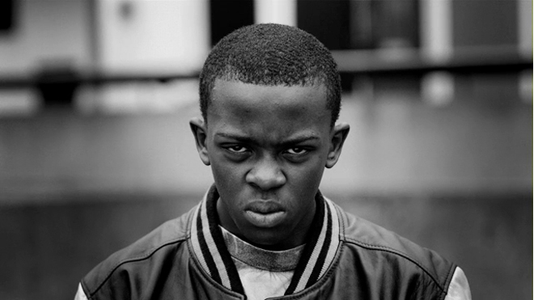
Fathers, do not provoke your children to anger, but bring them up in the discipline and instruction of the lord.
Ephesians 6:4
Stacyspencer.org
Notes:
The anger of the adolescent boys is the failure of the parents to support them.
God is calling the fathers to disciple and instruct the adolescents to help them to have maturity and have happy life.

Slide 12

Spiri-apps.com
Notes:
Discipline has to do with unconditional love. Adolescents need to know that it’s ok to make mistakes,
and there is grace and opportunity to start again in order to grow.
There is a validation of the experience.

Slide 13
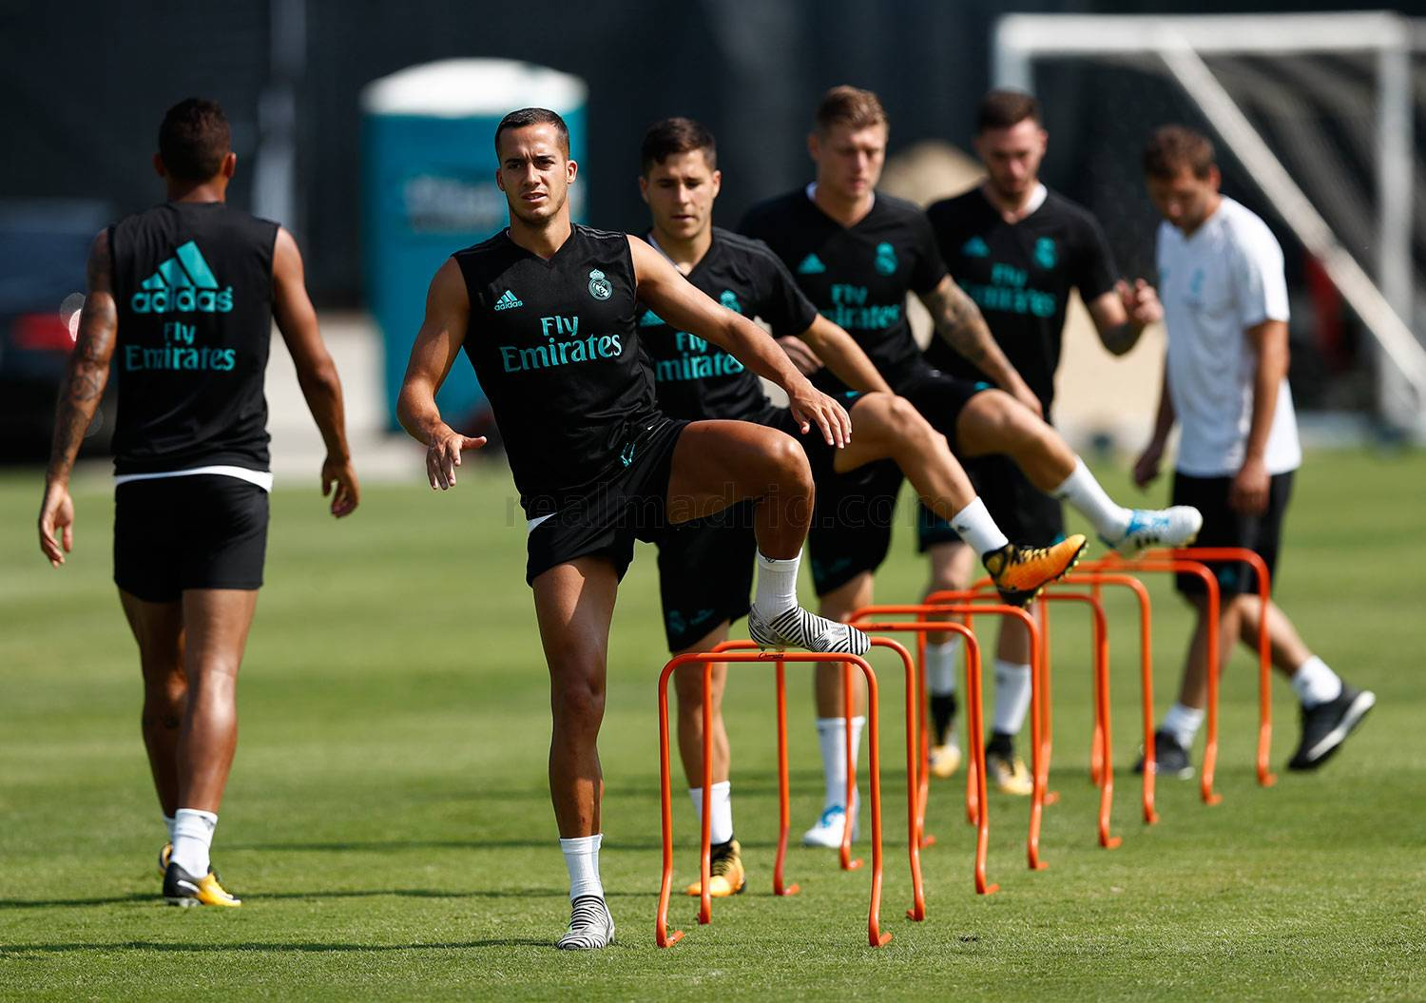
realmadrid.com
Notes:
Discipline is teaching about their uniqueness which is good but not always accepted by others and coping with emotion of loneliness,
setting rules, training in giving freedom and supporting them.

Slide 14
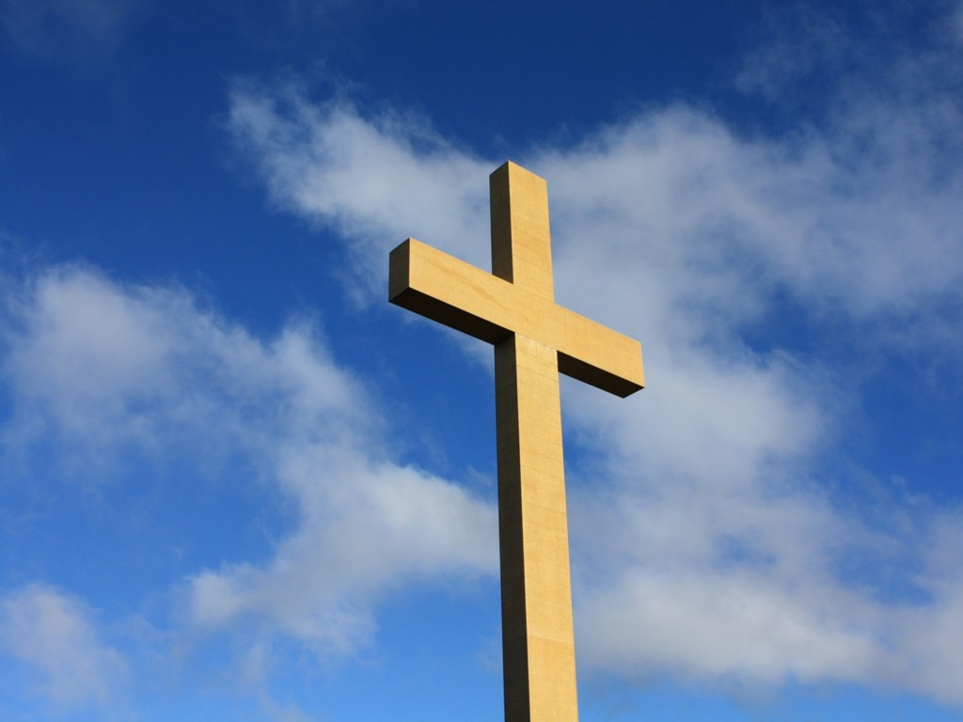
As for me and my house, we will serve you
Joshua 24:15
Pakinside.com
Notes:
Serving the lord is living the faith and having union with Jesus to die in the self,
bonding with the love of God to have fullness, and serving others with humility.

Slide 15
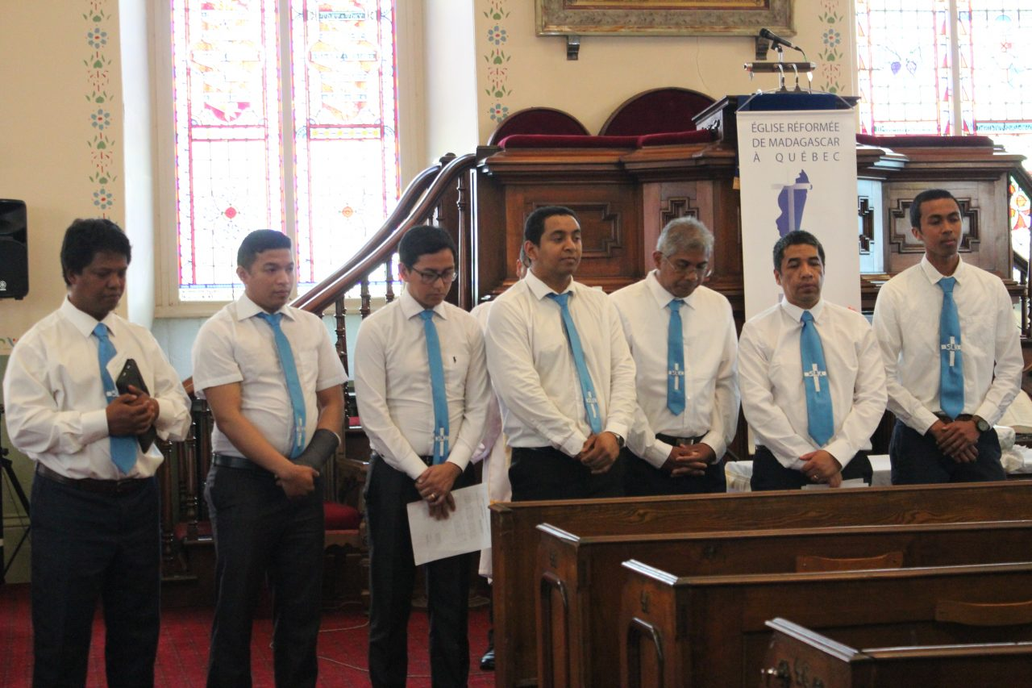
Fjkm-Quebec.ca
Notes:
To practice the Christian life in the family
Starting with the 41% Christian households in Madagascar,
fathers can grow in faith, embrace the fatherhood of God and learn from Jesus to lead the family without violence.
Then, they can be a good example for all the Malagasy men.

Slide 16


michaelleachings.com
Theological Basis of Family Relationship
Spiritual Musclehead
Notes:
To restore the Christian family life, The Theological Basis of Family Relationship is a good tool to use.
It is based on the Unconditional love of God with grace and forgiveness.

Slide 17
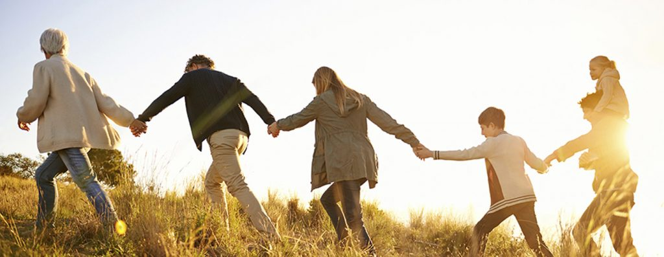
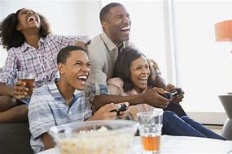
support
Jahlf.org
intimacy
Secureteen.com
Notes:
Also, it is based on the empowerment and intimacy that it forms a mature covenant,
and creates a healthy family with joy and peace.

Slide 18
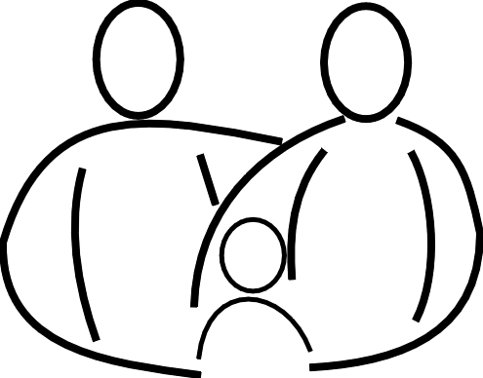
Family ministry
Aperfectworld.org
Notes:
Schooling for parents is needed to help them to be efficient in the precious and hard work of parenting.
They need someone to teach them how to live the faith at home to practice good relationship within the family.

Slide 19
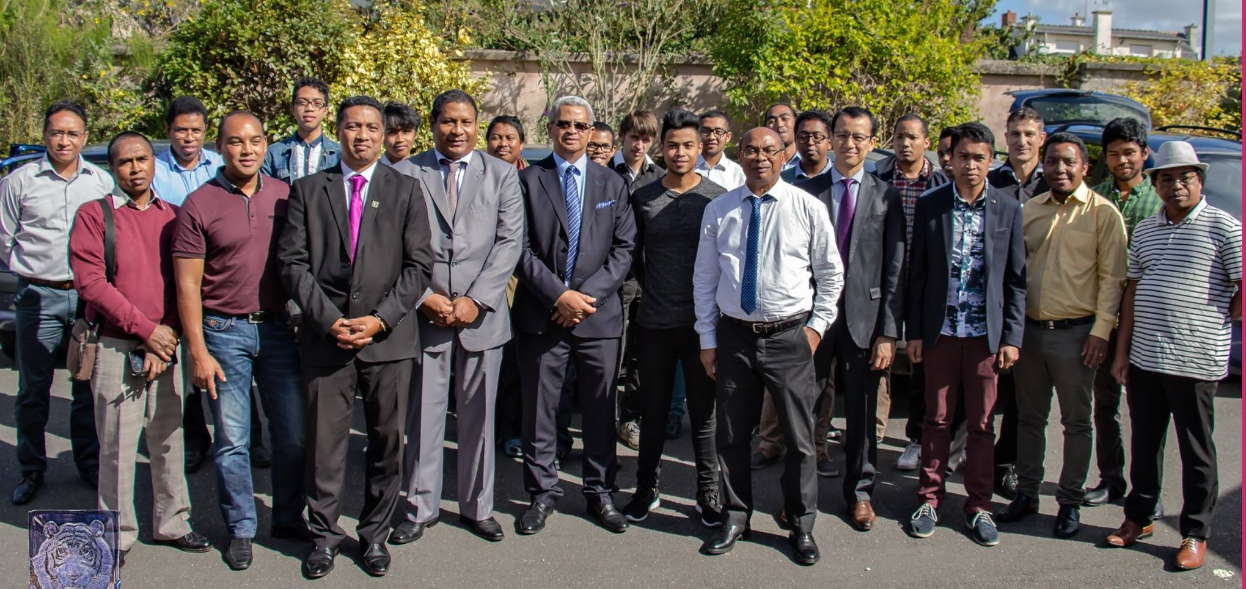
Fjkmrenneslaval.com
Notes:
Because of the high rate of domestic violence in Madagascar which is about 70% of the households,
men need support in their healing to become the image of the father God to the children, and
to lead the family with love and humility.

Slide 20
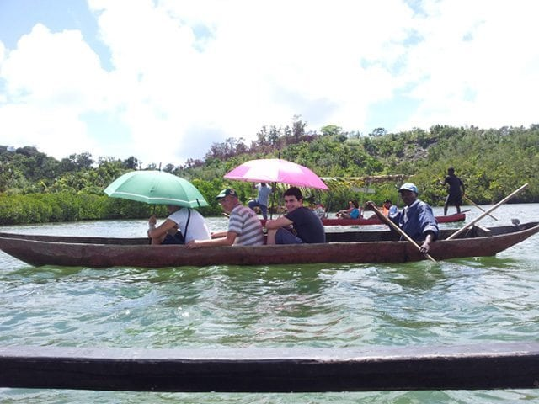
Trees for canoes come from good soil a Malagasy saying
Notes:
A famous Malagasy saying mentions “ Trees for canoes come from good soil”, and that is to value
the parenting work in Madagascar
This call is to encourage the fathers to hep the adolescent boys become good leaders and fathers.

